Slide 1

Electronic Data Interchange
( E D I )
By Muthuraja Learn @ Lunch Time

Slide 2
OUTLINE
Introduction
What is Electronic Data Interchange (EDI)?
EDI Users and Types of activities?
Who Uses EDI?
Types of EDI activities?
Business Processing Considerations
Where does information technology fit in?
What is needed to implement EDI?
International Considerations
Standards
Communication Connectivity
Is EDI for you?
By Muthuraja Learn @ Lunch Time

Slide 3
Introduction
Technology continually
offers new and innovative techniques
that affect companies and individuals:
Cordless telephone
Video games
Facsimile (fax) machines
Answering machines
Notebook Computers
Electronic mail (e-mail)
ATM Card
We are in the midst of the e-communications era
One innovation is electronic data interchange
Causing major changes in how companies conduct business
By Muthuraja Learn @ Lunch Time

Slide 4
What is EDI ?
EDI stands for Electronic Data Interchange
Definition of EDI
From Book: EDI is computer-to-computer communication using a standard data format to exchange business information between companies. (Ex: Consider the Postal System)
From Net: EDI is about doing business and carrying out transactions with your trading partners electronically.
EDI covers most things that are traditionally done using paper-based communication.
The EDI data standards process began in the United States with the transportation industry during the mid-1970s
In the early 1980s, the American National Standards Institute (ANSI) initiated efforts to define a single set of standards for EDI that could be applied across industries
These standards are known as the ASC X12 standards.
By Muthuraja Learn @ Lunch Time

Slide 5
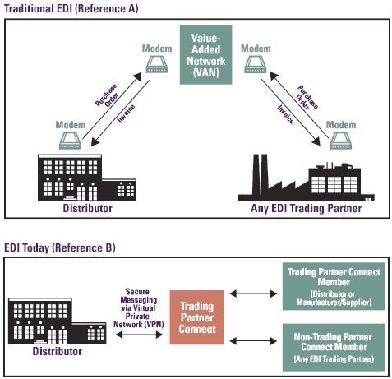
Traditional EDI (vs) Today’s EDI
By Muthuraja Learn @ Lunch Time

Slide 6
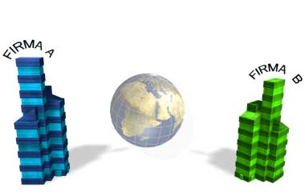
EDI Example
By Muthuraja Learn @ Lunch Time

Slide 7
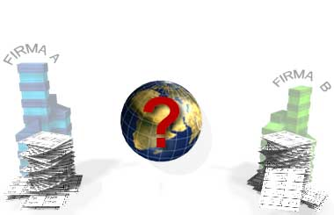
EDI Example
By Muthuraja Learn @ Lunch Time

Slide 8
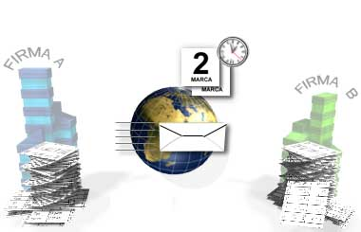
EDI Example
By Muthuraja Learn @ Lunch Time

Slide 9
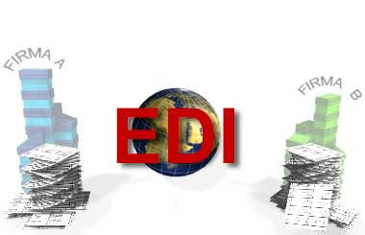
EDI Example
By Muthuraja Learn @ Lunch Time

Slide 10
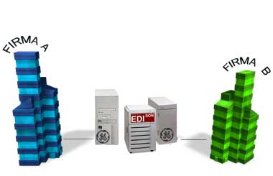
EDI Example
By Muthuraja Learn @ Lunch Time

Slide 11
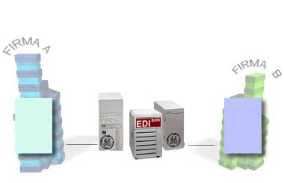
EDI Example
By Muthuraja Learn @ Lunch Time

Slide 12
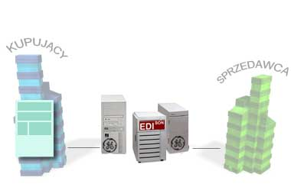
EDI Example
By Muthuraja Learn @ Lunch Time

Slide 13
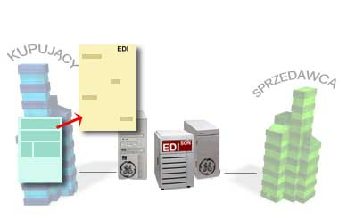
EDI Example
By Muthuraja Learn @ Lunch Time

Slide 14
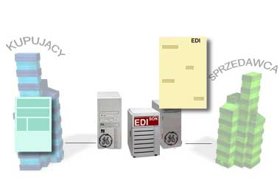
EDI Example
By Muthuraja Learn @ Lunch Time

Slide 15
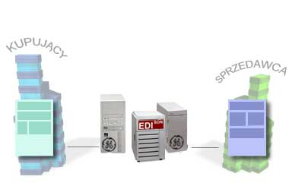
EDI Example
By Muthuraja Learn @ Lunch Time

Slide 16
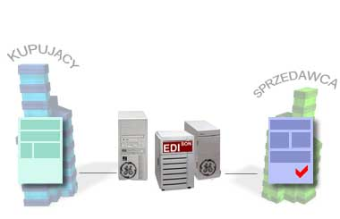
EDI Example
By Muthuraja Learn @ Lunch Time

Slide 17
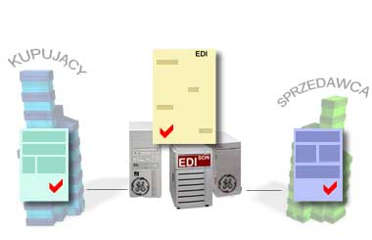
EDI Example
By Muthuraja Learn @ Lunch Time

Slide 18
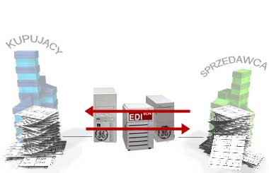
EDI Example
By Muthuraja Learn @ Lunch Time

Slide 19
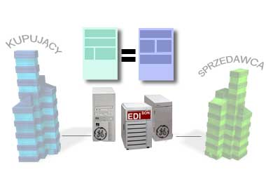
EDI Example
By Muthuraja Learn @ Lunch Time

Slide 20
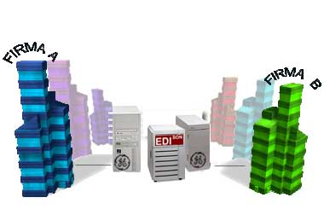
EDI Example
By Muthuraja Learn @ Lunch Time

Slide 21
EDI Users and Types of Activities
Who Uses EDI ?
Where is uses EDI ?
Types of EDI Activity
Business Processing Considerations
By Muthuraja Learn @ Lunch Time

Slide 22
EDI Users and Types of Activities
Who Uses EDI ?
Companies of all types and sizes are able to utilize EDI.
Companies that buys and/or sells (goods and/or services) can potentially use EDI.
Because it supports the entire business cycle
EDI can streamline the relationship that any company has with its (customers, distributors, suppliers)
By Muthuraja Learn @ Lunch Time

Slide 23
EDI Users and Types of Activities
Example:
Federal Government
Automakers (suppliers to send all purchase orders and invoices electronically)
Industry
Banking
Healthcare
Retailing
Travel
Manufacturing
Insurance
Government
and much other more places too…
By Muthuraja Learn @ Lunch Time

Slide 24
EDI Users and Types of Activities
Where is Uses EDI ?
Sample EDI application areas are …..
Purchasing
Inventory
Billing
Distribution
Price notification
Financial
Freight rate notifications
Sales & cash management
By Muthuraja Learn @ Lunch Time

Slide 25
EDI Users and Types of Activities
Types of EDI activity
Business’ local data to EDI
EDI Exchange
Convert EDI back to Business’ local data format
Sends out confirmation
Sends notifications
Further communication if needed
Example
Purchase orders
Bills of lading
Invoices
Healthcare claims
Financial exchanges
By Muthuraja Learn @ Lunch Time

Slide 26
EDI Users and Types of Activities
Difference between EDI & EFT (electronic funds transfer)
EFT is also used to exchange information electronically
Financial EDI is the exchange of payment and bank balance information between a company and its bank or another company.
EFT is the exchange of information between two banks that results in value being transferred.
It is possible for financial EDI to be bank to bank, but EFT does no bank-to-company exchanges.
By Muthuraja Learn @ Lunch Time

Slide 27
EDI Users and Types of Activities
Business Processing Considerations
EDI is changing the way companies do business
Shifting the ordering process from a snail-like
Paper-intensive system to a computerized one
The nature of business relationships, both internal and external, is changing.
By Muthuraja Learn @ Lunch Time

Slide 28
EDI Users and Types of Activities
Paper
Document
Little Envelope
Big Envelope
Postal Service
Courier Delivery
Human Audit
EDI
Transaction
Functional Group
Interchange
VAN (Network)
Point-to-Point
Machine Audit
(vs)
By Muthuraja Learn @ Lunch Time

Slide 29
Where does IT fit in ?
EDI is not simply a technical tool or technique
It offers change and new ways of conducting business
The involvement and role of the IT organization would be the same as for other business projects but entails crossing company boundaries
IT cannot be the sole implementer of EDI; it must be a business and technical team effort.
EDI should have its own architecture fixed to the company’s strategic way.
This EDI architecture at a minimum should be designed to handle any system:
Integration elements
Systematically
Address security levels
Communications connectivity to use
By Muthuraja Learn @ Lunch Time

Slide 30
Where does IT fit in ?
The EDI different between criteria and needs:
handling multiple data formats
multiple system interfaces
provides better support to the various Business Processing
It may be necessary to designate an EDI
Coordinator responsible (planning & coordinating) all EDI activity within the company.
The size of the firm and the extent of EDI activity :
deciding whether an additional full-time position is necessary
It is recommended that someone coordinate the EDI effort, regardless of the size of the effort, so that results are not fragmented throughout the company.
By Muthuraja Learn @ Lunch Time

Slide 31
What is needed to implement EDI ?
EDI Methodology
EDI Implementation Considerations
Business Strategic Planning
Build External Company Relationships
Ensure Commitment and Acceptance
Legal and Tax Implications
Standard Data Formats
EDI Data Standards History
Standard Group Types
Implementing Standards
Data Standards Software
Establishing Electronic Connections
By Muthuraja Learn @ Lunch Time

Slide 32
What is needed to implement EDI ?
Establishing Electronic Connections
In addition to a standard data format, it is mandatory that the companies’ computers are able to “talk” to one another.
This sounds simple but it can be complex. EDI entails the use of special translation and communications software.
When connecting computers, companies must consider the communications method and protocol that will be used to transmit information, as well as security and business recovery.
By Muthuraja Learn @ Lunch Time

Slide 33
What is needed to implement EDI ?
Establishing Electronic Connections
Protocol: A set of standards for exchanging information between two computer systems or two computer devices.
Communications protocol: A list of communications parameters (settings) and standards that govern the transfer of information between computers using telecommunications. Both computers must have the same settings and follow the same standards to avoid errors.
Communications program: An application program that turns your computer into a terminal for transmitting data to and receiving data from distant computers through the telephone system
By Muthuraja Learn @ Lunch Time

Slide 34
International Considerations
Standards
EDI is not used only in the United States or North America.
Data format standardization efforts are taking place in the United States (ANSI) and internationally (ISO).
Until there is one common standard base, EDI implementation must be flexible enough to handle multiple standards for the same type of document
By Muthuraja Learn @ Lunch Time

Slide 35
International Considerations
Communication Connectivity
When dealing with international communications, there are numerous concerns other than the obvious language and cultural barriers
In some countries, telephone lines are government regulated and are not as efficient as in the United States.
When the government runs the show, acquiring permission from telecommunications authorities for equipment connection often causes delays.
Another concern is the level of data security available and the right of ownership during transmission
By Muthuraja Learn @ Lunch Time

Slide 36
Pros & Cons of EDI
Advantages
Reduces the flow of paper
Cost savings
Speedy interactions
Improves productivity
Strong business security
Allows for more efficient disbursement of info.
Improves accuracy of info and reduces errors.
Just-in-time support.
Disadvantages
Standardizes programs & procedures
Lack of understanding & limited edu.
Complex to use
By Muthuraja Learn @ Lunch Time

Slide 37
Is EDI for you ?
Companies should be wary of vendors that try to convince them how easy and inexpensive it is to implement EDI.
This is partially true, but before spending money, all implications and expenditures should be considered.
Communication costs, ongoing maintenance, hardware costs, data volumes, and data availability should be investigated before investing.
A word of warning: it is difficult to quantify costs and determine a return on investment for using EDI because it is a complex system which affects multiple business functional areas.
By Muthuraja Learn @ Lunch Time

Slide 38
Any question ?
refer this site for all EDI documents’ guide & formats
http://www.1edisource.com/transaction-sets-x12
By Muthuraja Learn @ Lunch Time

Slide 39
Thank You
By Muthuraja Learn @ Lunch Time

